Slide 1



Mia Weber & Brandon Kamplain
Minesweeper Mania:
The Minesweeper Solver
Notes:
Discuss documentation too (where are they stored and what did we use for documentation)
Software management: GitHub issues, ClickUp (Kanban Board)
Divison of labor/teamwork -> add GitHub commit chart

Slide 2
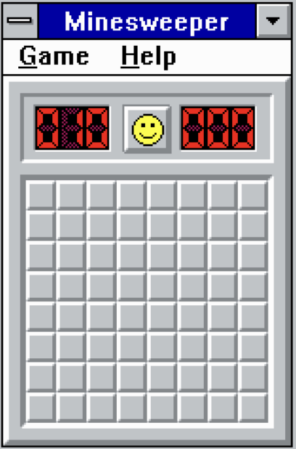
Minesweeper
Grid of hidden spaces – empty or mine
Click to reveal a space – empty, mine, or number
Right-click to place a flag and identify a mine
Game over when mine is revealed
Game is won when all mines are flagged
Minesweeper is NP-Complete
Notes:
---NP-complete = An efficient computer program or algorithm that will give the answer in all cases.
Because Minesweeper is NP-Complete we can use Minesweeper board configurations to represent things like Boolean circuits
Because it's NP-Complete, is actually very difficult to identify cases where it is possible to reveal a space safely and be confident that it is empty, and cases when some guessing is required.
Even if you are told in advance that guessing is NOT required, it will still be difficult to decide what spaces to clear.
----------------------------
The fact that it is NP-complete means that it is very difficult to spot when it is possible to clear a square safely in full knowledge that that square is clear, and when some guessing is required. In fact, even if you are told in advance that guessing is not required, it may still be difficult to decide what squares to clear. In some sense, when you play the game you cannot be expected to do much better than the hundreds of very good mathematicians who have worked on the P=NP? question for many many years.
https://web.mat.bham.ac.uk/R.W.Kaye/minesw/ordmsw.htm
https://minesweeper.info/articles/MinesweeperIsNPComplete.pdf

Slide 3
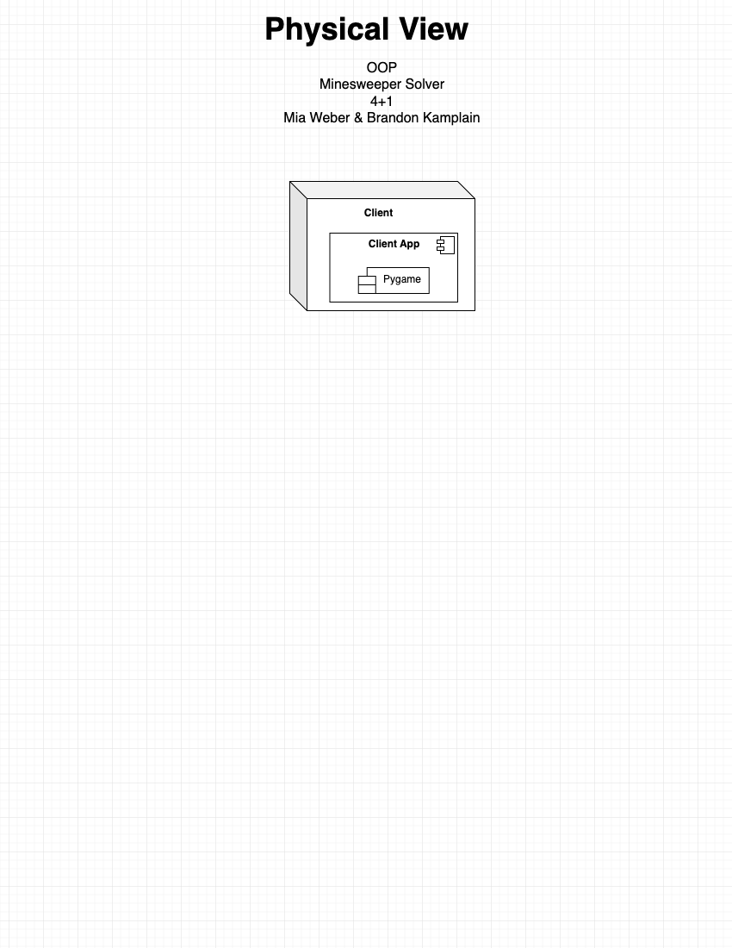
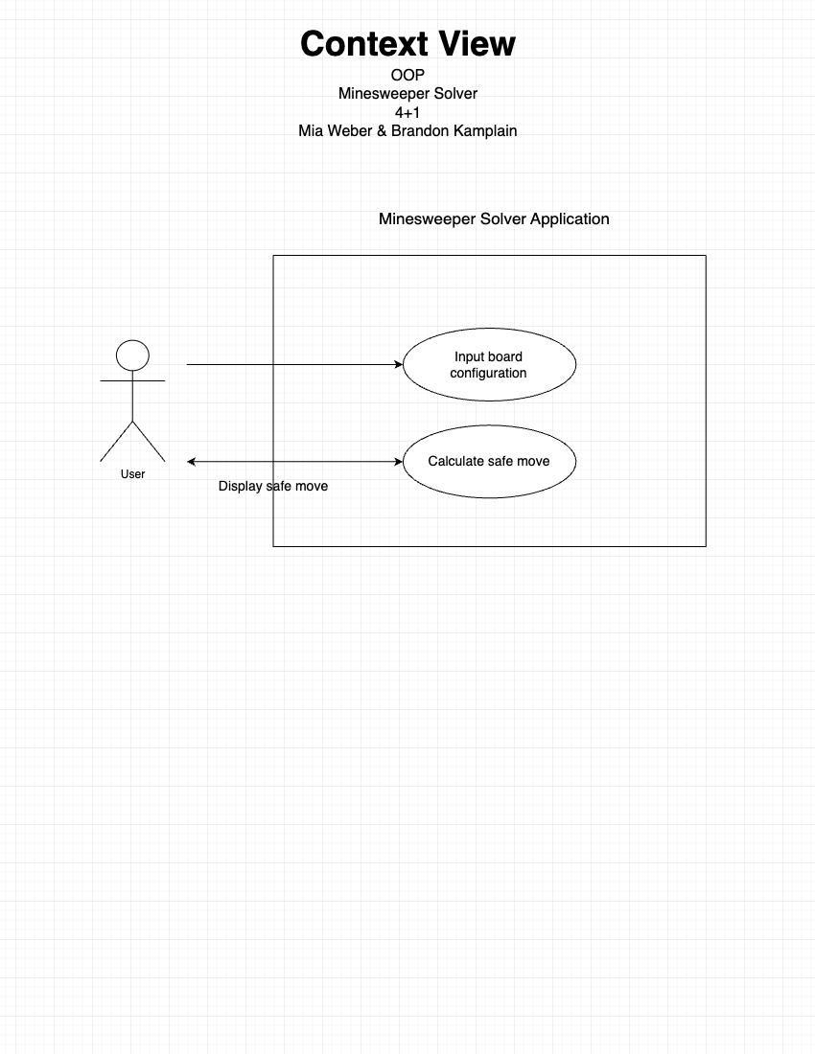
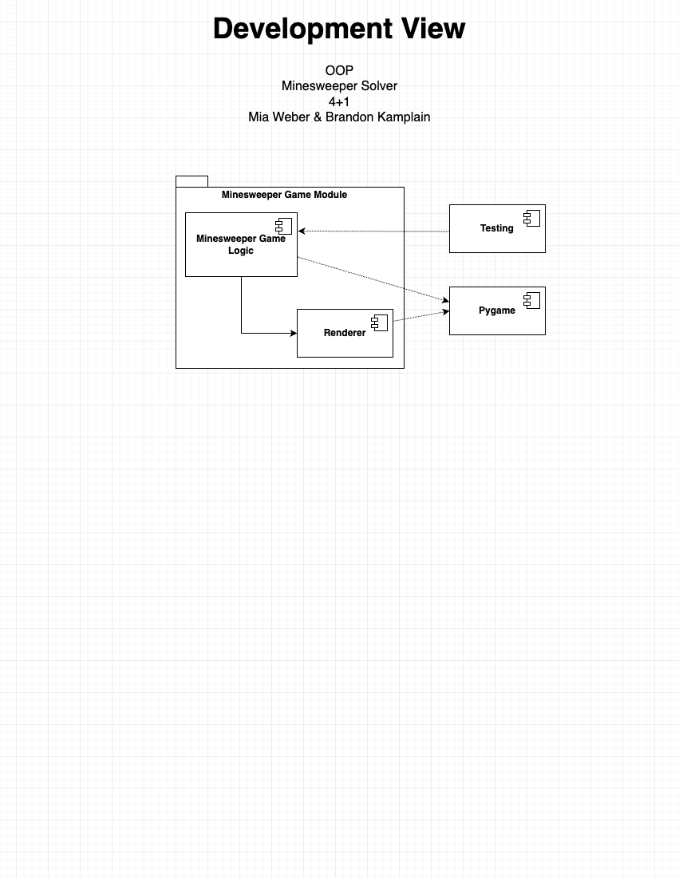
4+1 Diagrams
Notes:
Physical View:
The minesweeper solver runs on the client and doesn’t interact with any other resources. It utilizes the Python library pygame for game state rendering.
Development View:
The game logic and solver are encapsulated and are as independent as possible from the renderer. Both interact with pygame, however only the renderer is responsible for using pygame to display things to the game window. Testing was also isolated from the game module.
Context View:
The user interacts with the application by providing the input board configuration (the width and height of the game board and the number of mines to place). Then the user places the mines on the board. Then the application will calculate the safe move and display it back to the user until the game is over (either a win or a loss).

Slide 4
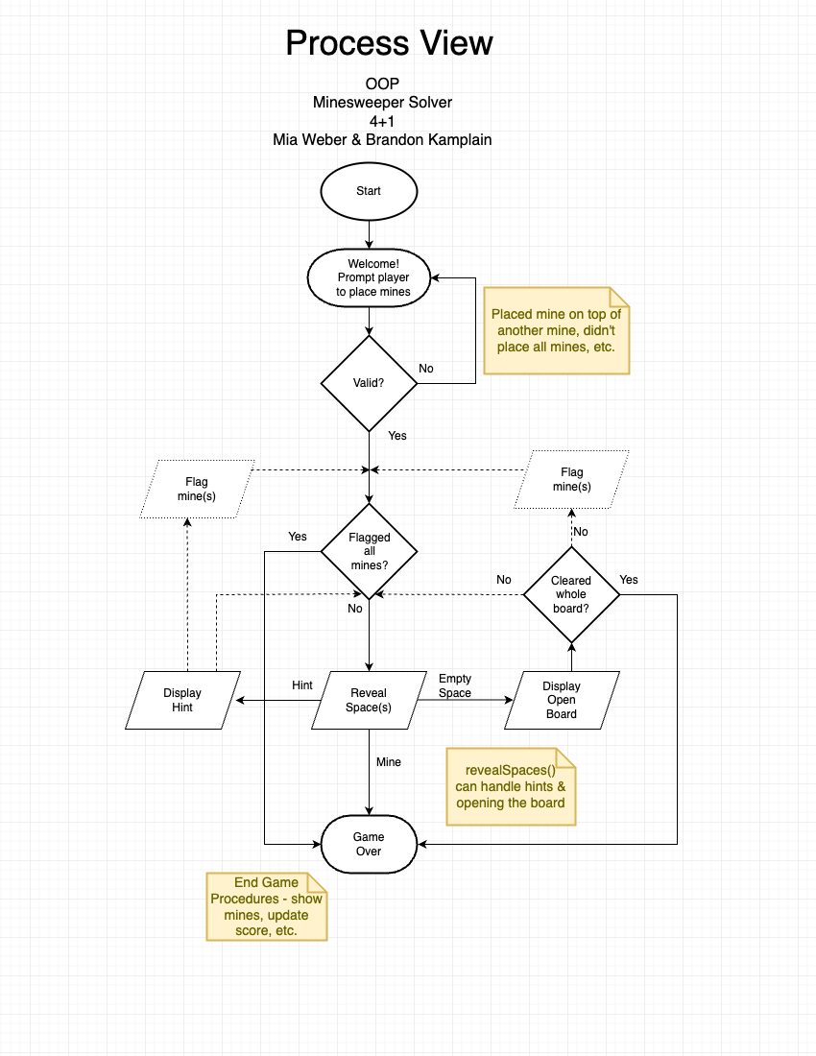
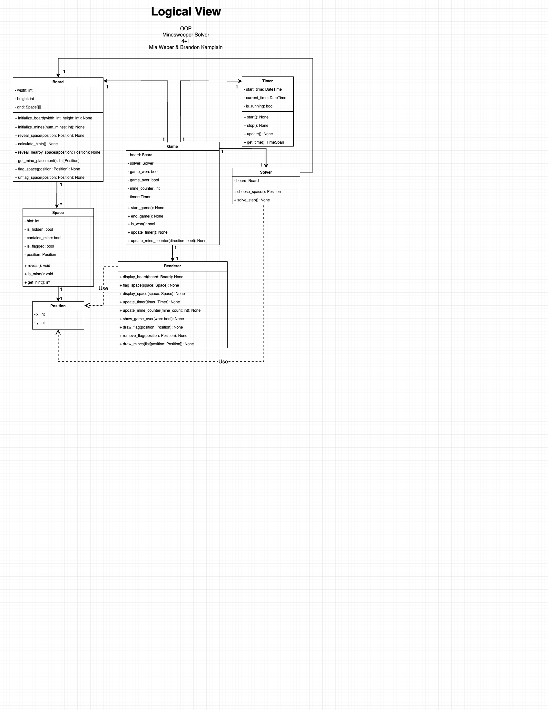
4+1 Diagrams
Notes:
Explain how the solver works (heuristics)

Slide 5
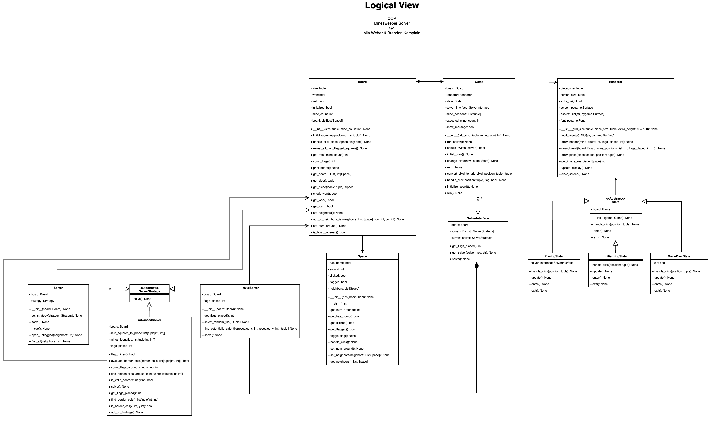
4+1 Diagrams

Slide 6
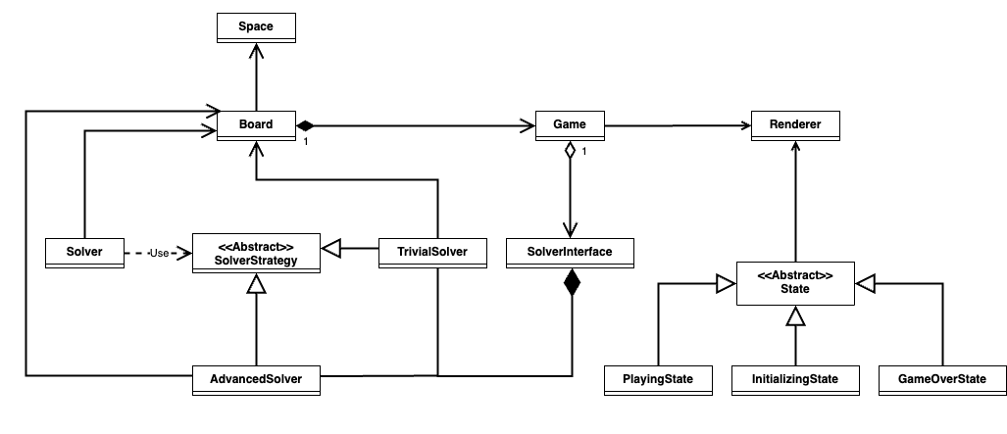
4+1 Diagrams

Slide 7
Design Patterns
State
01
Initializing State, Playing State, Game Over State
Singleton
03
Game, Board
Strategy
02
Trivial Solver, Advanced Solver
Notes:
Identify & how we used them.
State = State is a behavioral design pattern that lets an object alter its behavior when its internal state changes. It appears as if the object changed its class.
Strategy = Strategy is a behavioral design pattern that lets you define a family of algorithms, put each of them into a separate class, and make their objects interchangeable.
Singleton = Singleton is a creational design pattern that lets you ensure that a class has only one instance, while providing a global access point to this instance. ->STRATEGIES HAVE INSTANCES OF BOARD, DOES THIS STILL COUNT?

Slide 8
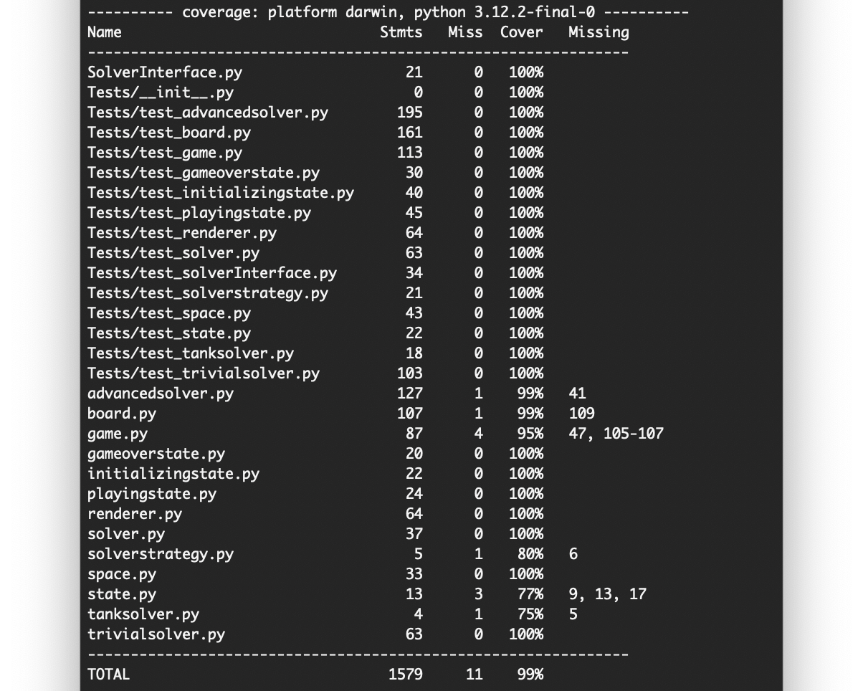
Testing
Use of unittest, hypothesis, patch, & mock
Code Coverage Report: 99%
Used type annotations (mypy) and PEP8 style guidelines (flake8)
Notes:
Testing & Other things that Brandon worked on…
Discuss code coverage report (put charts and reports on slide)

Slide 9
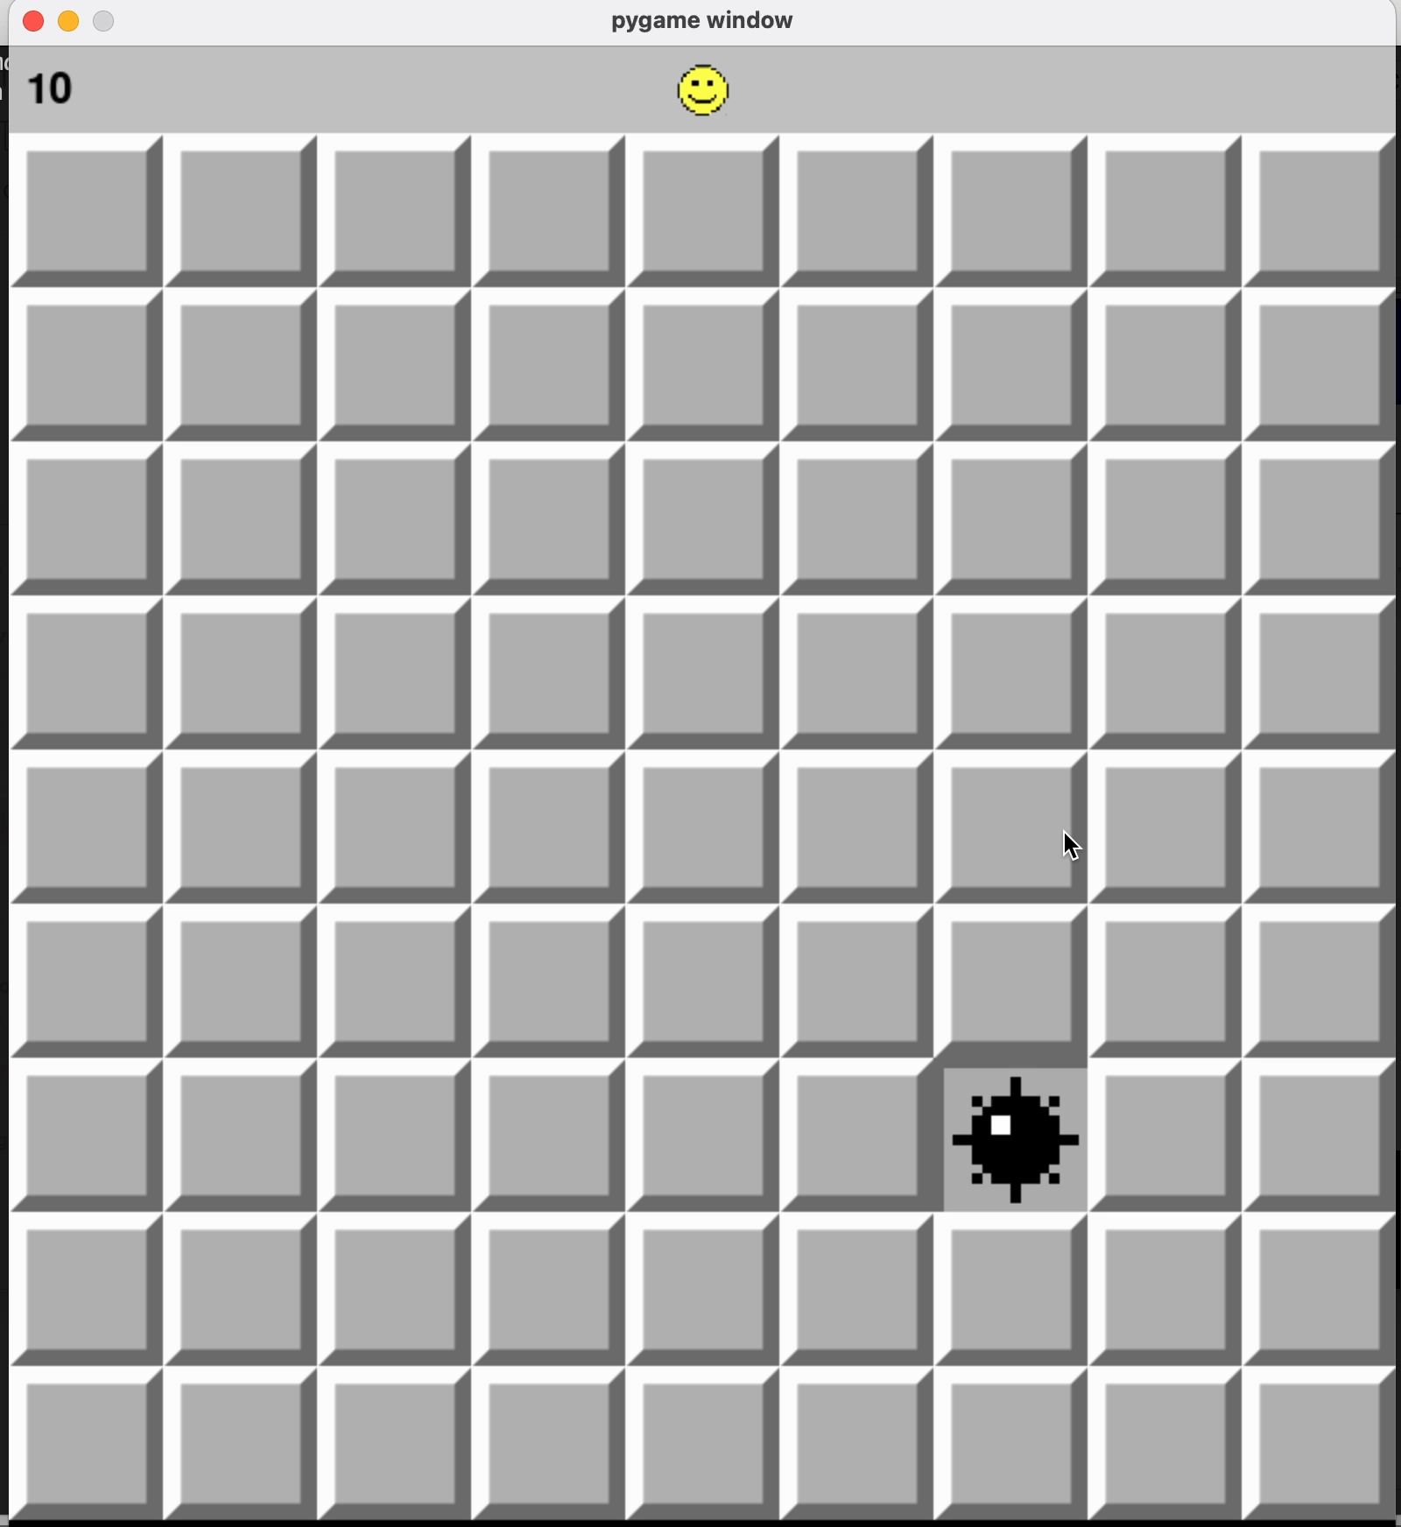
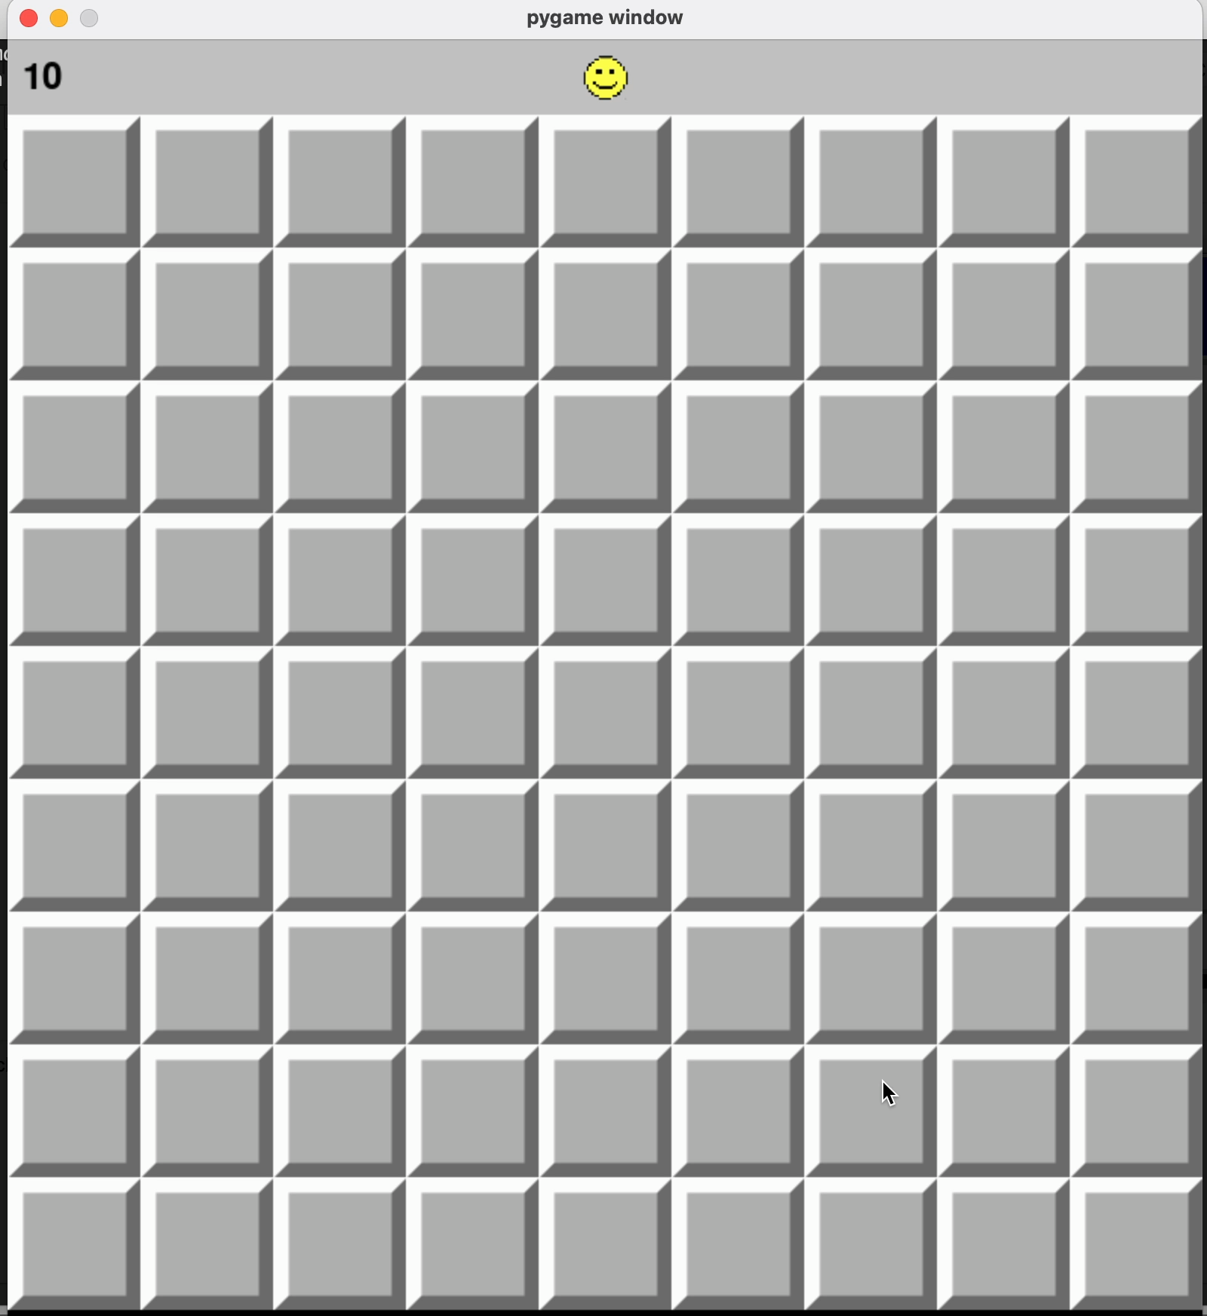
Demo 9x9 (10)
Notes:
6:30
BRANDON:
- solver goes faster than pygame will render

Slide 10
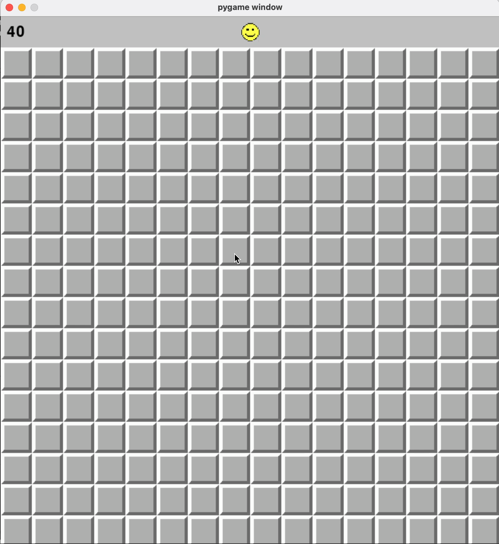
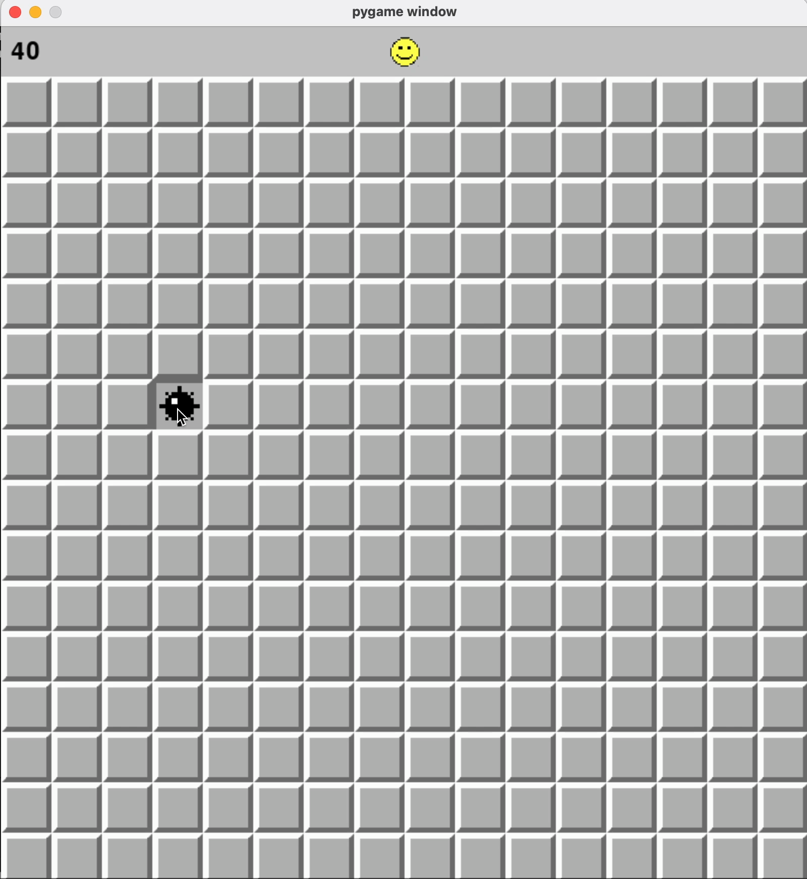
Demo 16x16 (40)
Notes:
BRANDON:
- congested mine placement vs spread out (timing)
MIA:
- trivial solver vs advanced solver progress
- does better with less mines (board size not as important)
- percentages of solver success (stuck state)
100% for 9x9
30% for 16x16 (40)
40-45% for 16x16 (30 and under)

Slide 11
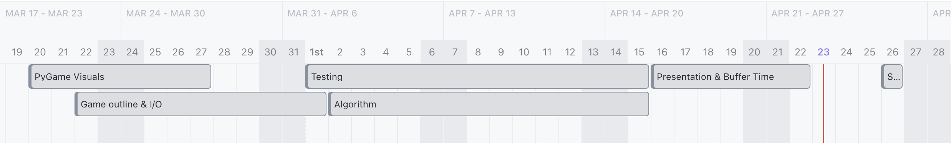
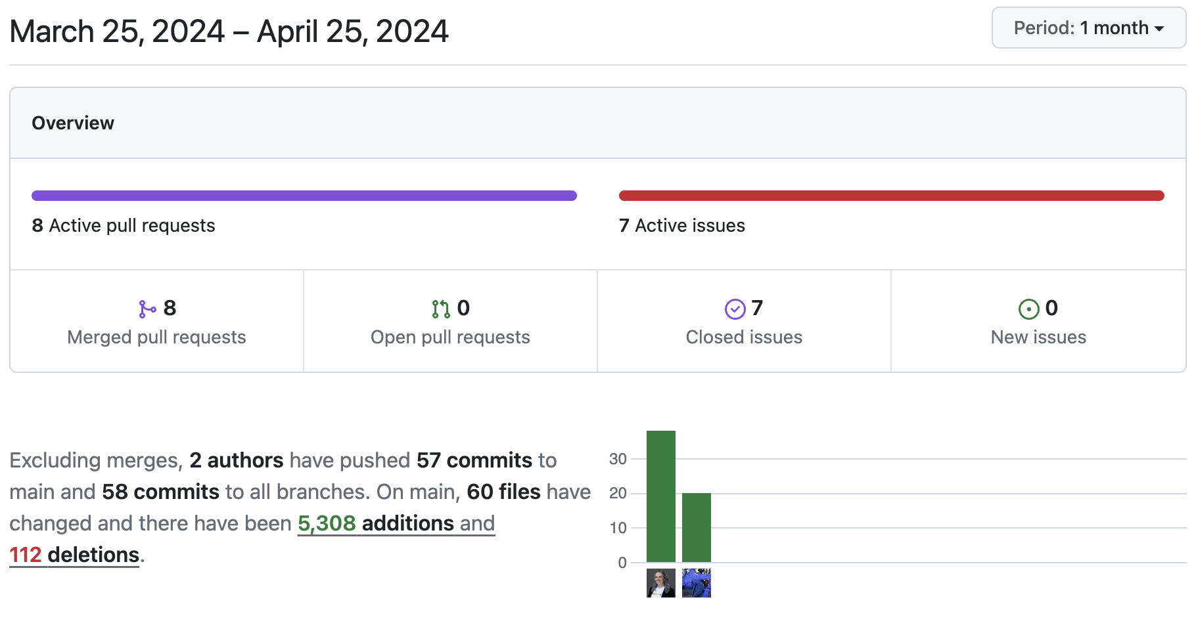
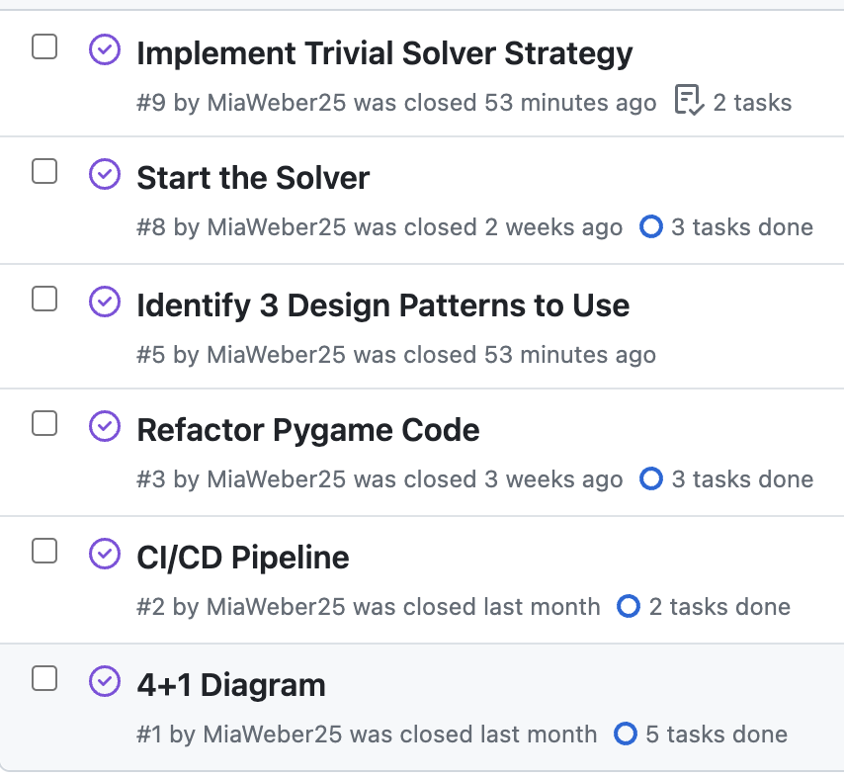
Documentation
Notes:
BRANDON:
Code & other things Mia worked on…
Discuss and explicitly point out OOP concepts & patterns (Getters, setters, design patterns, etc.)
Discuss how we used GitHub, ClickUp
Touch on requirments for the project (if relevant)

Slide 12
Works Cited
“Algorithmic Solution to Minesweeper.” Stack Overflow, 1 Jan. 2013, stackoverflow.com/questions/15957116/algorithmic-solution-to-minesweeper?noredirect=1&lq=1+https%3A%2F%2Fgithub.com%2FMing-Tang%2FMinesweeper%2Fblob%2Fmaster%2Fsrc%2Forg%2Fshinkirou%2Fminesweeper%2FMinesweeperSolver.java#L27.
Chang, Daniel. “Pygame/Minesweeper at Main · DANIELCHANG2002/Pygame.” GitHub, 2020, github.com/danielchang2002/Pygame/tree/main/Minesweeper.
“Design Patterns.” Refactoring.Guru, refactoring.guru/design-patterns. Accessed 18 Apr. 2024.
“How to Write Your Own Minesweeper Ai.” Lucky’s Notes, 5 Feb. 2017, luckytoilet.wordpress.com/2012/12/23/2125/.
Kaye, Richard. “Minesweeper and NP-Completeness.” Minesweeper and NP-Completeness, web.mat.bham.ac.uk/R.W.Kaye/minesw/ordmsw.htm. Accessed 18 Apr. 2024.
Kaye, Richard. Minesweeper Is NP-Complete., 2000, www.minesweeper.info/articles/MinesweeperIsNPComplete.pdf.
“Microsoft Windows 3.10.” Microsoft Windows 3.10, www.pcjs.org/software/pcx86/sys/windows/3.10/. Accessed 18 Apr. 2024.
“Minesweeper Solving Algorithm.” Stack Overflow, 1 Aug. 2022, stackoverflow.com/questions/1738128/minesweeper-solving-algorithm.
Pradipta, Nayotama. Implementation of Backtracking Algorithm in Minesweeper, 2022, informatika.stei.itb.ac.id/~rinaldi.munir/Stmik/2021-2022/Makalah/Makalah-IF2211-Stima-2022-K2%20(34).pdf.
ChatGPT was used to aid in the construction of unit tests and to review code and check for correctness

